Slide 1
Essential technology infrastructure upgrades
Educational Services Division
by
Rabinder Mangewala and Ryan Choate
March 2015

Slide 2
Technology to Support 21st Century Teaching and Learning
Fiber Loop
Connection to Loop
Switches and Internal Fiber
Additional Devices
New WIFI
Increased Internet Bandwidth
Today
Today
In Contract
In Contract

Slide 3
Switches and Internal Fiber
SLUSD published a Request for Proposal to replace our switches and internal fiber at all sites
These upgrades are an essential component of our technology infrastructure upgrades to support 21st century teaching and learning

Slide 4
Internet bandwidth
SLUSD also published a Request for Proposal to increase the Internet bandwidth to match the speed of the Fiber Loop
This is also an essential component of our technology infrastructure upgrade to support 21st century teaching and learning

Slide 5
Selection Committee
The Selection Committee consisted of the following:
Dr. Rosanna Mucetti (Deputy Superintendent)
Mark Martinelli (Associate Superintendent)
Paul Disario (Consultant)
Rabinder Mangewala (Director Technology, Assessment, Research and Evaluation)
Ryan Choate (Chief Technology Officer)
Brian Feeley (Network Manager)

Slide 6
Winning Vendors
After multiple meetings and thorough analysis, the following vendors were chosen based on the published matrices:
Lynbrook (Switches)
AMS (Fiber)
AT&T (Internet transportation to the District Office)
ACOE (Internet Bandwidth)

Slide 7
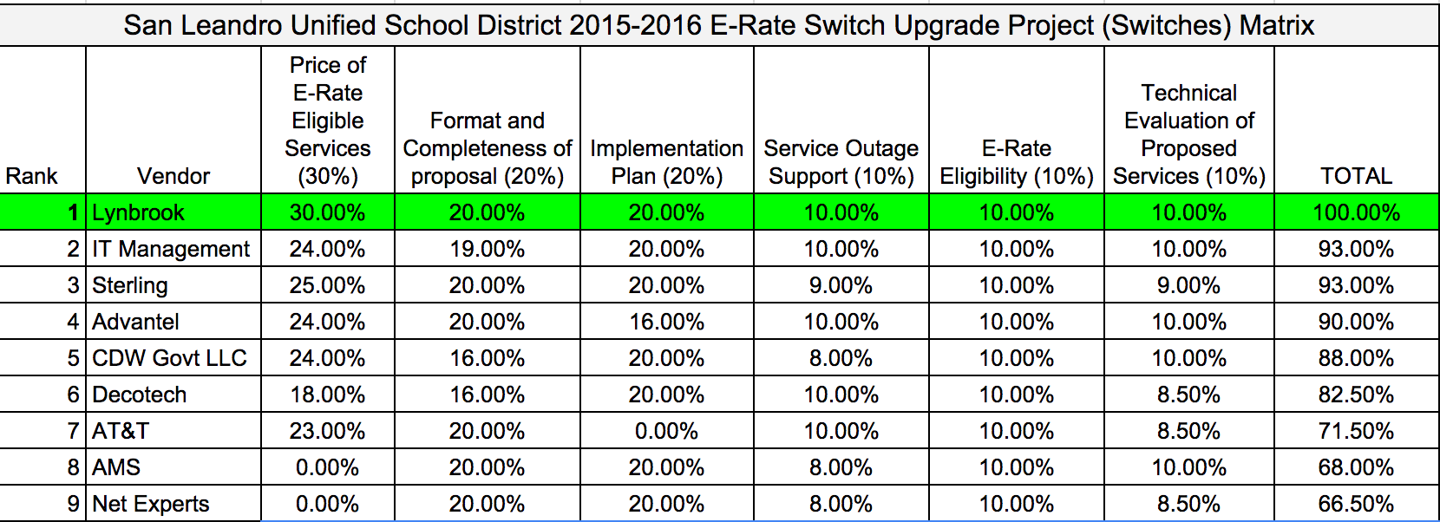

Slide 8
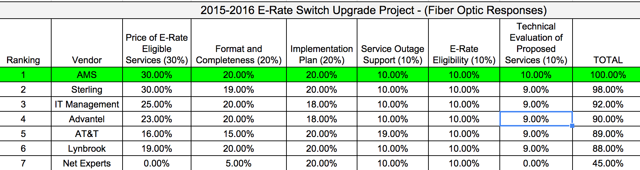

Slide 9
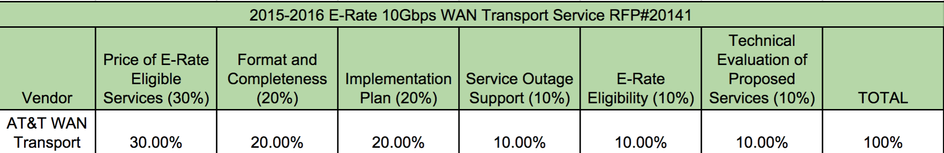

Slide 10
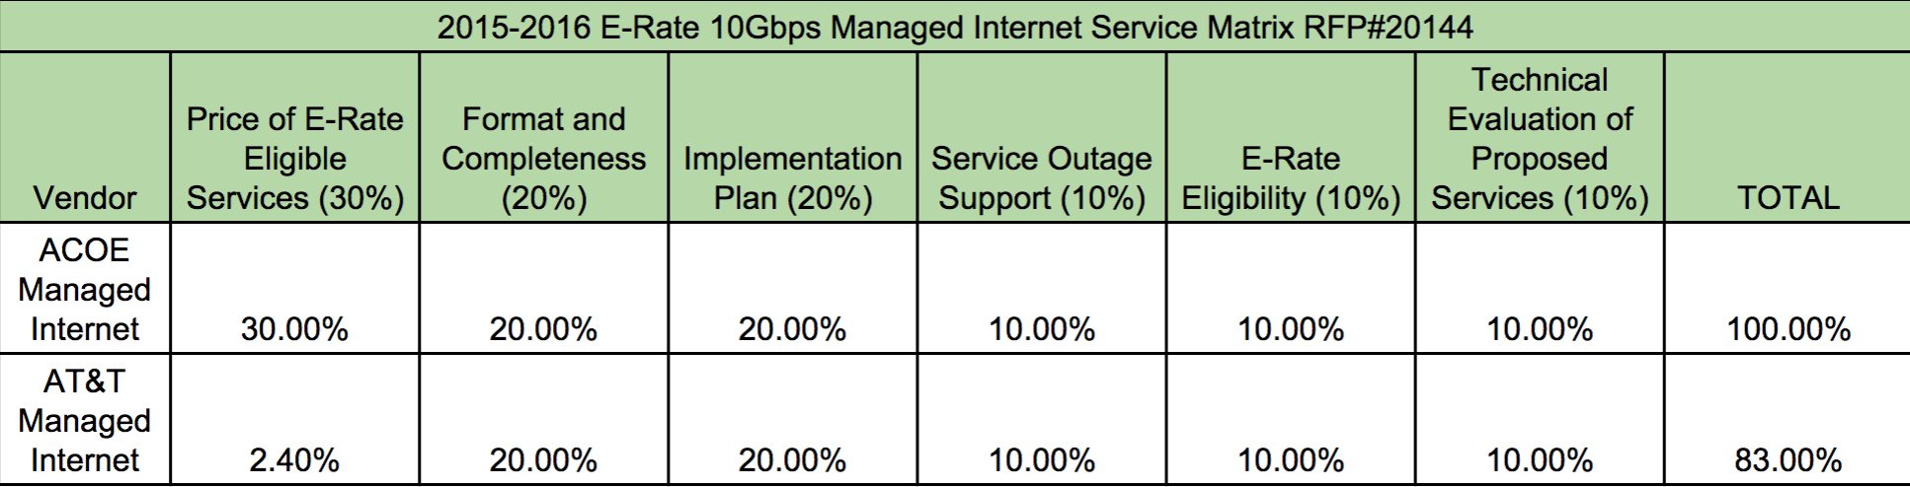

Slide 11
Cost of projects
Switch Upgrade
      $891,394.94
  Internal Fiber Upgrade:
    $333,869
Total Cost for Both Projects: $1,225,264

Slide 12
Source of funds
Switch Upgrade
      QZAB
  Internal Fiber Upgrade:
    QZAB

Slide 13
E-Rate
Applying for a partial refund via E-rate

Slide 14
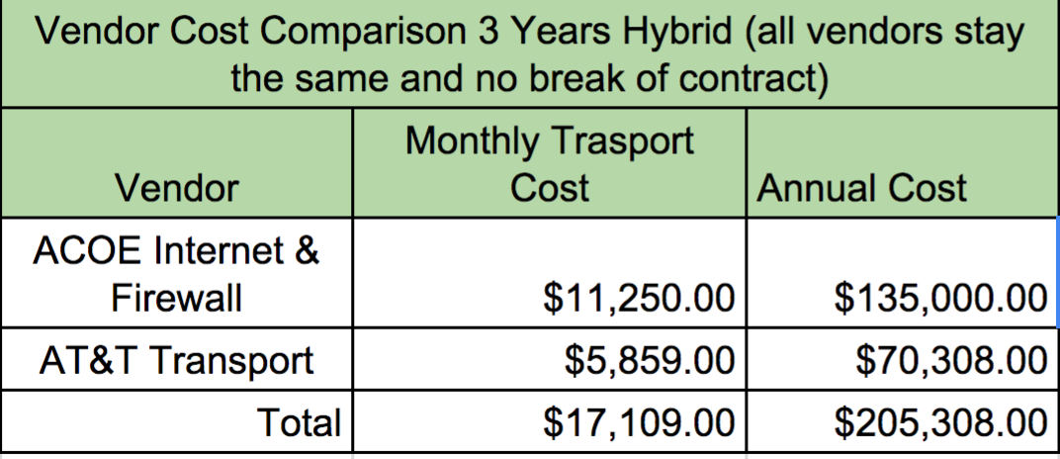
Cost of increased bandwidth, firewall, and internet transportation

Slide 15
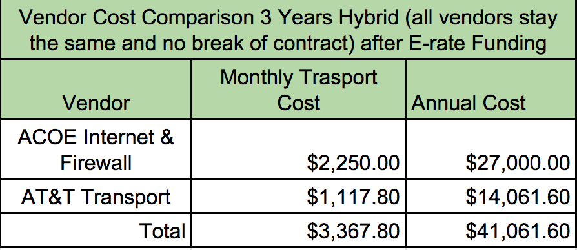
E-Rate
Will apply for E-rate Funding via the SPI Method
Discount to be received on bill
Estimated at 80% discount

Slide 16
Source of funds
Internet Bandwidth
General Fund
Internet Transportation
General Fund

Slide 17
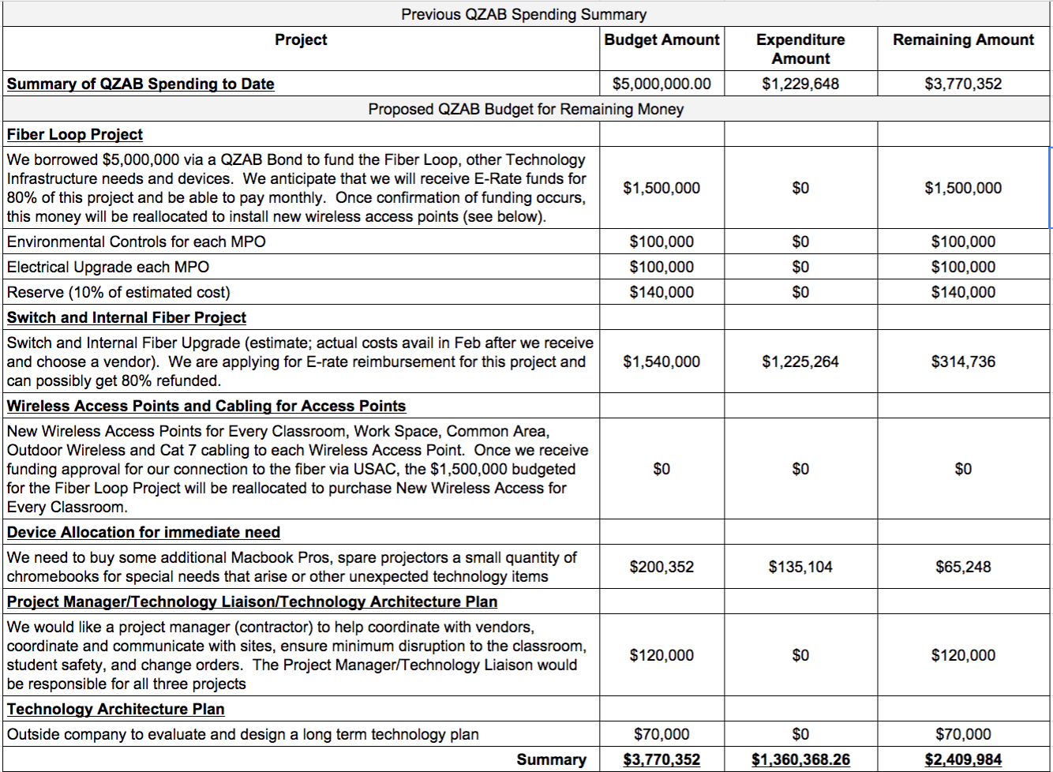

Slide 18

Questions?

