Slide 1
  California Assessment of Student Performance and Progress (CAASPP)
Educational Services Division
by
Rabinder Mangewala
March 2015

Slide 2
AB 484
STAR
Standardized Testing and Reporting
CAASPP
California Assessment of Student Performance and Progress
Notes:
Governor Brown signed AB 484 in October 2013, which created California Assessment of Student Performance and Progress (CAASPP)

Slide 3
CAASPP in 2015
Online Assessments:
SBAC
Paper-Pencil Assessments
CST/CMA/CAPA science tests
Notes:
The assessments that comprise the 2015 CAASPP administration are a mix of online and paper-pencil assessments. The online component contains the Smarter Balanced English language arts/literacy (ELA) and mathematics tests. The paper-pencil component includes CST/CMA/CAPA science tests and the optional STS for RLA.

Slide 4
Smarter Balanced Assessment Consortium (SBAC)
Grades 3rd–8th and 11th
Both ELA and Math
Notes:
4

Slide 5
About the
Summative Assessments
Content areas:
English language arts/literacy (ELA)
Mathematics
Two components per content area:
Computer adaptive test (CAT)
Performance task (PT)
Notes:
Four tests: split into multiple sessions.
5

Slide 6
Summative Assessments:
Computer Adaptive Tests
Assessments will increase or decrease in difficulty based on performance
Student assessments will vary from each other
Notes:
The computer adaptive portion of the online test includes a wide variety of item types. As students progress throughout a CAT, the computer program adjusts the difficulty of questions throughout the assessment based on their responses. For example, a student who answers a question correctly will receive a more challenging item, while an incorrect answer generates an easier question.
6

Slide 7
Early Assessment Program
Grade 11 SBAC is the EAP
Student must make a choice during testing regarding scores being released to CSU and CCC at the end of computer adaptive test
Notes:
The Early Assessment Program (EAP) will be using the grade 11 Smarter Balanced summative assessments in English language arts/literacy (ELA) and mathematics in place of the grade 11 CSTs in ELA and/or mathematics, additional 15 test questions and the ELA essay
Grade 11 students taking the Smarter Balanced summative assessments may choose to release their test results to the California State University (CSU) and participating California Community Colleges (CCC) at the end of the computer adaptive tests
Students who do not authorize the release of their test results at the time of testing may need to provide a copy of the score report upon request of the campus.
7

Slide 8

Preparing for the SBAC

Slide 9

Notes:
All administrators, testing coordinators and teachers are being trained; we are providing administrators with all training materials to ensure consistency.

Slide 10

PREPARING STUDENTS
Notes:
Practice Tests and Training Tests
Have taken interim assessments online

Slide 11

Devices for TESTING
Notes:
Chromebook is the primary device
Some labs will be used at secondary
11

Slide 12

Technology Infrastructure
Notes:
Made improvements, but need to make significant additional improvements to support online assessments and 21st Century Teaching and Learning
Need to limit access to the internet during 8-12 am to testing only during testing window at each site and potentially the entire district
May need to reset wifi passwords to ensure that student devices are not on the network
12

Slide 13
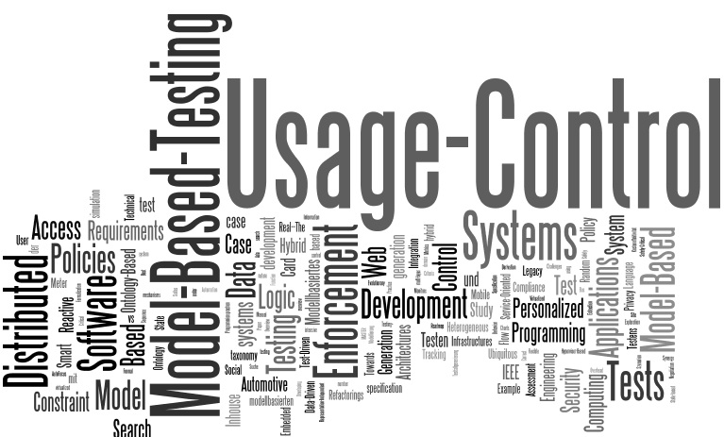
Building a model
Notes:
Monroe has offered to test first
Allow us to work out infrastructure or procedure issues
Scale Up
13

Slide 14
 | Practice Test | Training Test
Purpose | Provide students with a grade specific testing experience similar in structure and format to the summative assessments | Provide students with an opportunity to quickly become familiar with the software and interface features. There are no performance tasks (PTs).
Grade Levels | Each grade: 3–8, 11 | Grade bands: 3–5 6–8 High school
Number and Types of Items | Approximately 30 items in ELA and 30 items in math per grade level Includes 1 ELA PT and 1 math PT per grade level | Approximately 15 items per grade band (6 in ELA and 8–9 in math); PTs are not available
Universal Tools, Designated Supports, and Accommodations | All | All
Scoring | Results are not scored, however answer keys and scoring rubrics are available | Results are not scored
Notes:
Illustrative example of the differences between the Practice and Training tests
14

Slide 15
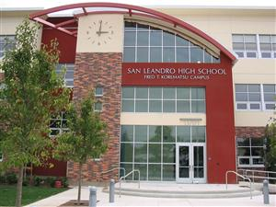
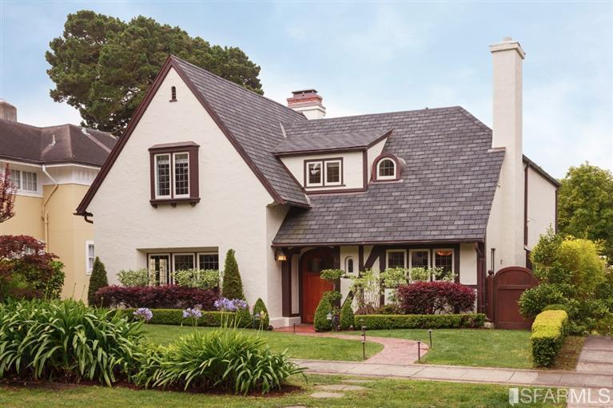
Access to Practice and Training Tests
Notes:
Practice and training tests will be taken at school and can also be taken anywhere an internet connection is available
15

Slide 16
Estimated Testing Time
Content Area | Grades | Computer Adaptive Test (CAT) items hrs : mins | Performance Task (PT) hrs : mins | Total hrs : mins | Classroom Activity (administered prior to the PT)* hrs : mins | Total hrs : mins
English Language Arts/Literacy | 3–5 | 1:30 | 2:00 | 3:30 | :30 | 4:00
 | 6–8 | 1:30 | 2:00 | 3:30 | :30 | 4:00
 | 11 | 2:00 | 2:00 | 4:00 | :30 | 4:30
Mathematics | 3–5 | 1:30 | 1:00 | 2:30 | :30 | 3:00
 | 6–8 | 2:00 | 1:00 | 3:00 | :30 | 3:30
 | 11 | 2:00 | 1:30 | 3:30 | :30 | 4:00
Both | 3–5 | 3:00 | 3:00 | 6:00 | 1:00 | 7:00
 | 6–8 | 3:30 | 3:00 | 6:30 | 1:00 | 7:30
 | 11 | 4:00 | 3:30 | 7:30 | 1:00 | 8:30
Notes:
16

Slide 17

Expectations Around Student Performance
Notes:
17

Slide 18
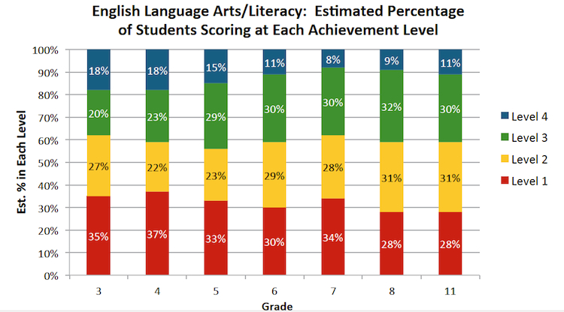
Scoring Predictions - ELA
Notes:
These predictors are taking into account the student performance on the Field Test from last year.
There are 4 levels or bands. Currently the bands have not been provided names.

Slide 19
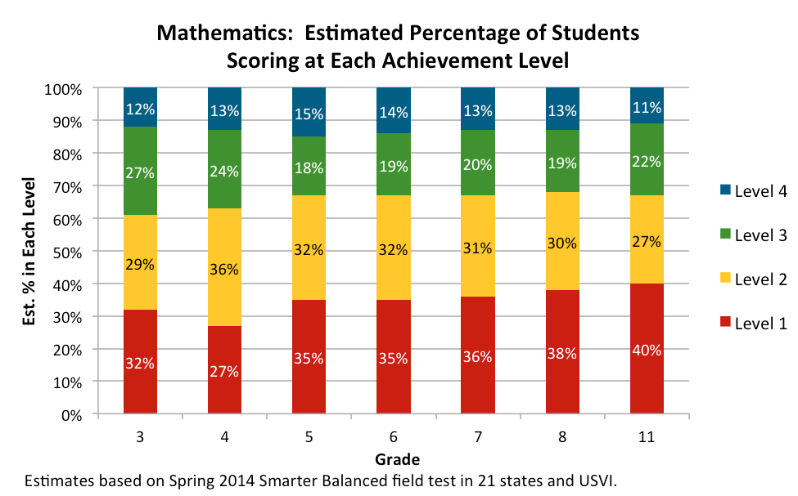
Scoring Predictions - Math

Slide 20

Program Improvement and AYP:
Uncertainty and Unknowns
Notes:
20

Slide 21

Questions?

